Slide 1

Dashboard capstone
Redlining
Divergence Academy 2022

Slide 2

AGENDA
ABOUT ME
PROJECT OVERVIEW
DATA DICTIONARY
DEMO
PROCESSES AND PROCEDURES
PAIN POINTS/LESSONS LEARNED

Slide 3





Andrew Champion About Me
Veteran –
USMC – Corporal – 6 years
US ARMY – Staff Sergeant – 10 years
College –
University of North Texas
Social Work
Psychology
Civilian Experience –
Amazon – Logistical Manager
Aspirations
Data Scientist
This Photo by Unknown Author is licensed under CC BY-SA
This Photo by Unknown Author is licensed under CC BY-SA

Slide 4



PROJECT OVERVIEW
REDLINING
LOAN
Encapsulated Data will paint the picture of where the redlining issues are found by race and grade throughout the United States. Source Data pulled in the year 2020.

Slide 5
Data Dictionary
HOLC | Homeowners Loan Corporation
GRADE | A – Best ; B – Still Desirable ; C – Definitely Declining ; D – Hazardous (color/grade coding assigned by company)
LQ | Quotient for a given grade and location
SURROUNDING AREA | Estimated population within HOLC zones
RACE | Based on racial/ethnic grouping. Other is all other racial/ethnic grouping not listed

Slide 6
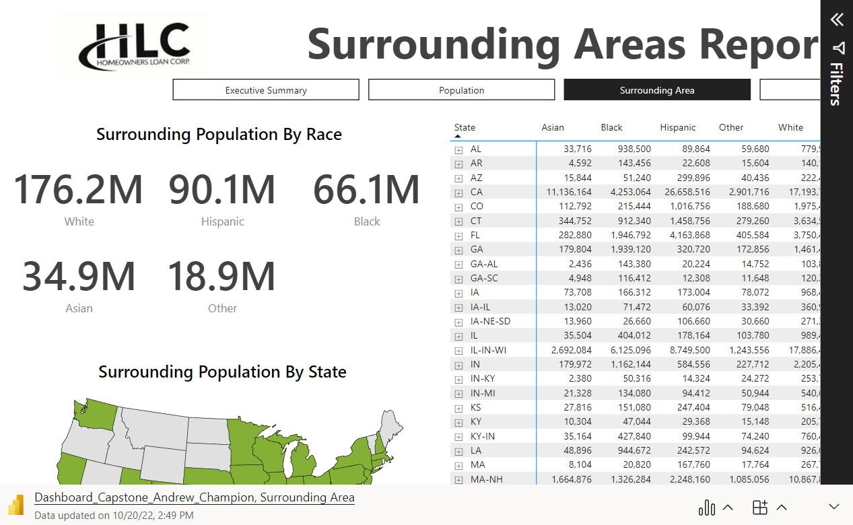
DEMO

Slide 7
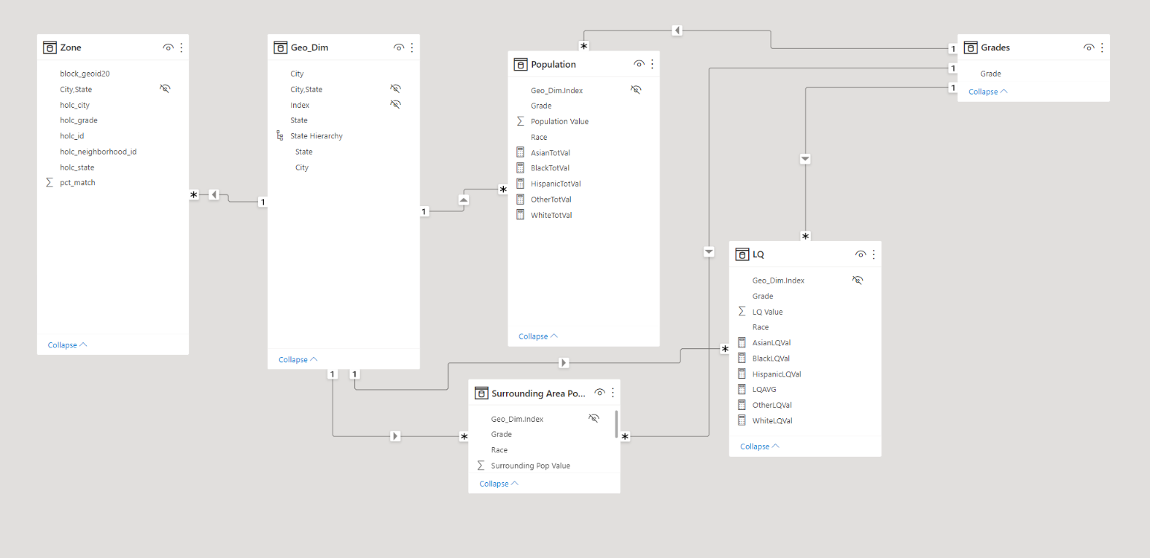
PROCESSES AND PROCEDURES
Redlining CSV Files
Data from the above Redlining CSV files created the data model to the left. After cleaning files, the relationships where created withing Power Query

Slide 8
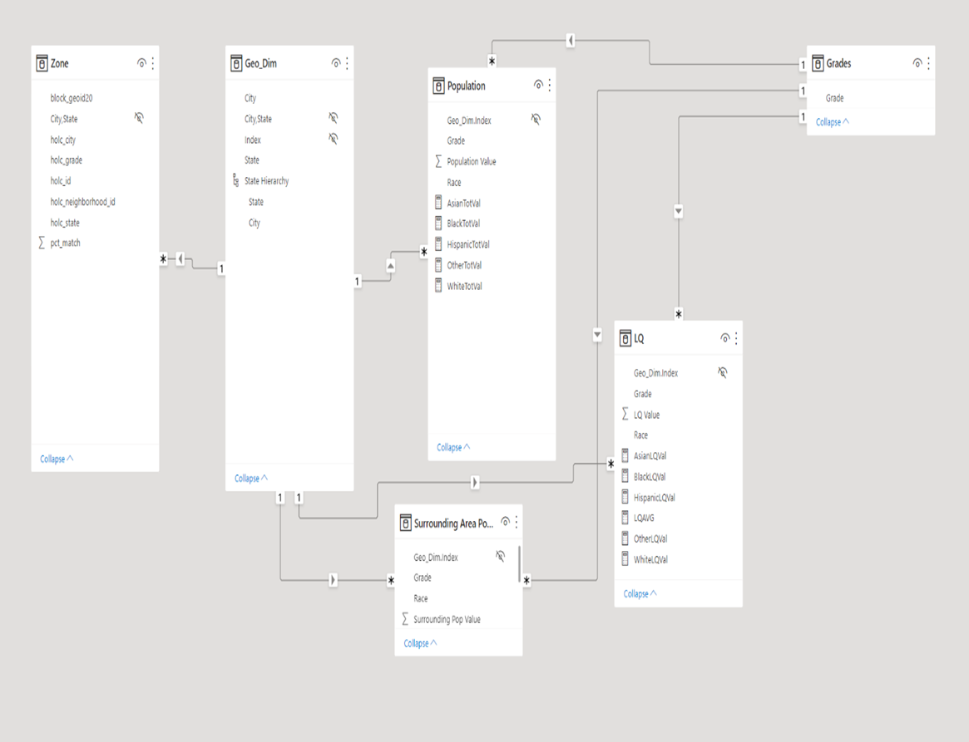
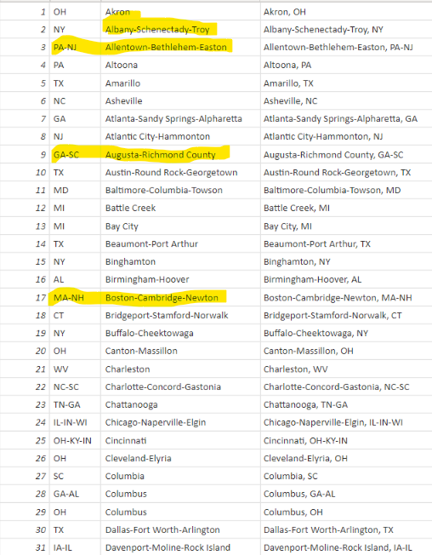
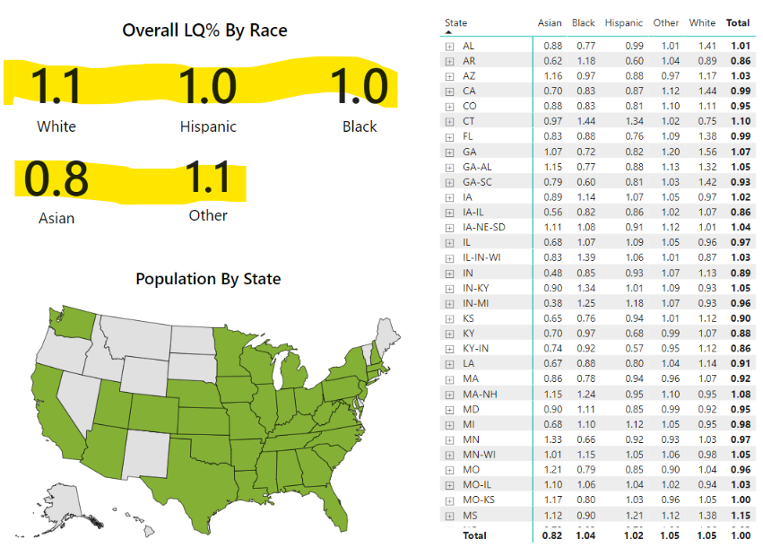
PAIN POINTS/LESSONS LEARNED
Slicer → Measure:
Had to create new table for slicer due to slicer not affecting measured values.
LQ Values:
LQ measures/redundancy
Table Values
Data Cleanup/Manipulation
City combinations
State combinations

Slide 9
Q & A

